Slide 1
Data Mining Using Pseudo-Cellular Automata with Update Rules based on Local Gradients

Slide 2
Cellular Automata
A Cellular Automation is a discrete simulation
Occurs on a grid (or higher-dimensional cell space)
Cells exhibit discrete states
Cellular Automata are
Discrete in both space and time
Homogenous in space and time
Local in their interactions

Slide 3
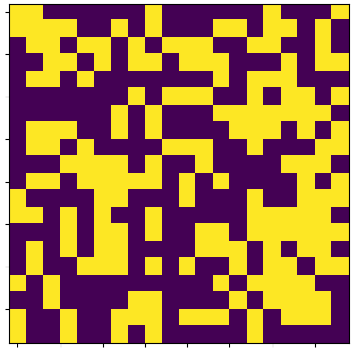
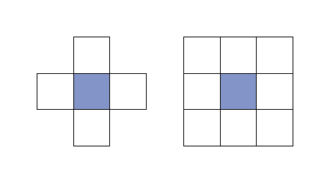
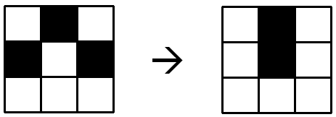
Cellular Automata Properties
Discrete States
Neighborhoods
von Neumann
Moore
Update Rules

Slide 4
Example: Conway’s Game of Life
Source: www.jakubkonka.com

Slide 5
Example: Conway’s Game of Life
Rules:
A cell is “born” (a dead cell becomes alive) when it has exactly three living neighbors
A living cell dies if it has fewer than two living neighbors or more than three living neighbors
A living cell remains alive if it has two or three alive neighbors

Slide 6
Cellular Automata
Global Phenomena
An interesting consequence of cellular automata
Source: Wikipedia

Slide 7



Mathematical Representation
A good overall resource on cellular automata:
Jarkko Kari. “Cellular Automata.” 2013.
http://www.cs.tau.ac.il/~nachumd/models/CA.pdf
Defined via the following components:
$$A=(d, S, N, f)$$
$$N=(\vec{n_{1}}, …,\vec{n_{m}})$$
$$f: S^{m}→S$$

Slide 8
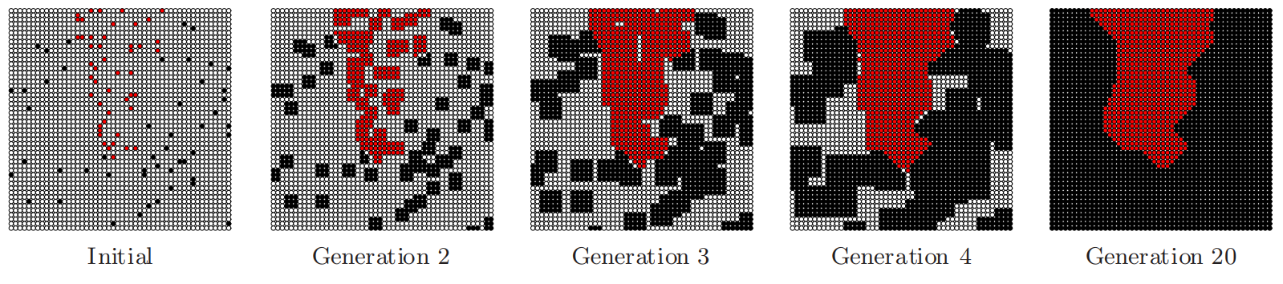
Application to Classification
Cellular automation used as a classifier:
Tom Fawcett. “Data mining with cellular automata.” Association for Computing Machinery's Special Interest Group on Knowledge Discovery and Data Mining (SIGKDD) Explorations. 2008.
https://www.kdd.org/exploration_files/V10N1-DMCA.pdf
Source: Fawcett Paper

Slide 9
Methods

Slide 10
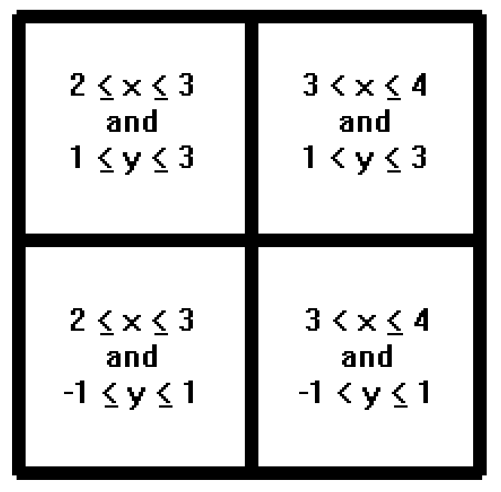
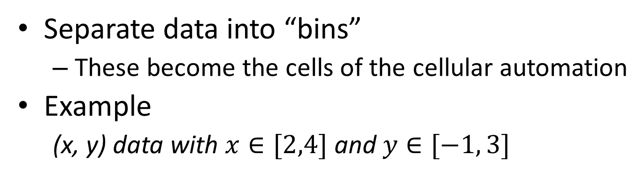
Defining A Cell Space
Separate data into “bins”
These become the cells of the cellular automation
Example
(x, y) data with $x∈[2,4]$ and $y∈[−1, 3]$

Slide 11
A Pseudo-Cellular Automation Method
Goals:
Create a method with better performance than “simple” cell automata
Perform at a level similar to standard classification methods (ex. SVM), like Fawcett’s Automata
Show additional benefits of using this type of method

Slide 12
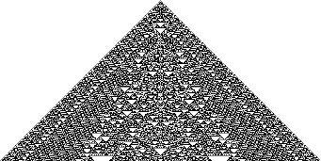
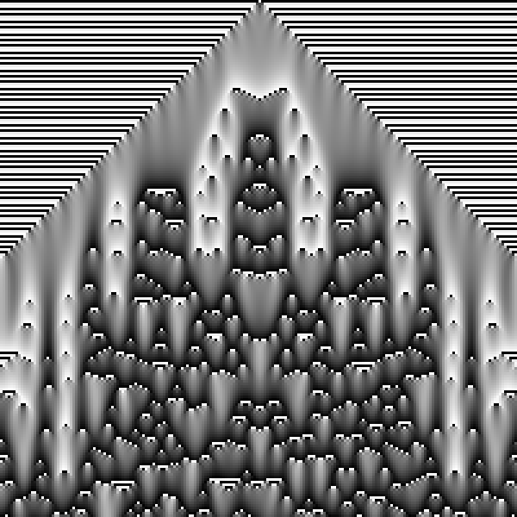
A Pseudo-Cellular Automation Method
Rules will be broken:
Discrete in both space and time
Homogenous in space and time
Local in their interactions
Source: Wolfram Mathworld
http://i.imgur.com/G2Ujx6a.png

Slide 13
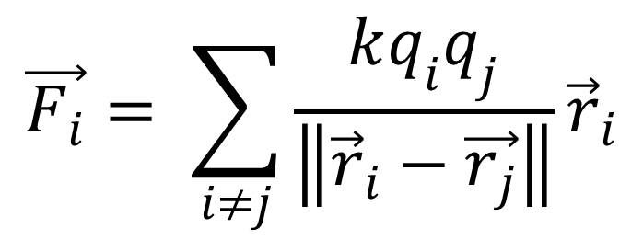
A Pseudo-Cellular Automation Method
Proposal:
Define cell “Fitness” as well as “Species” (class)
Base cell growth on Coulomb’s Law and Gradients
Use a Moore neighborhood for an “initialization” step, but use von Neumann neighborhoods for “growth”
$$\vec{F_{i}}= \sum_{i≠j}{\frac{kq_{i}q_{j}}{\left\|{\vec{r}}_{i}−\vec{r_{j}}\right\|}{\vec{r}}_{i}}$$

Slide 14
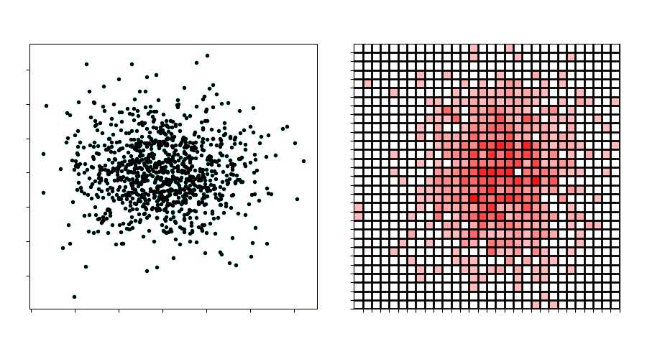
Pseudocode
Separate training data into cells where the number of data points defines the “fitness” of a cell

Slide 15
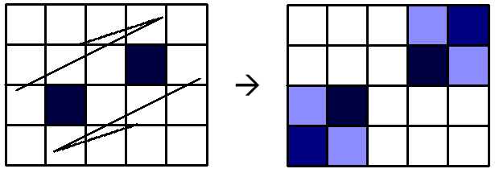
Pseudocode
Apply an initial growth step using “Moore neighborhoods” based on global Coulomb repulsion

Slide 16
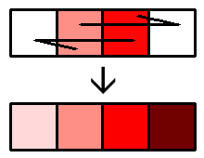
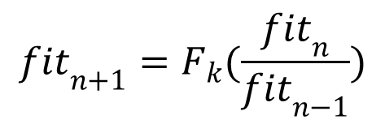
Pseudocode
Cells are grown via local rules
A repulsion vector is calculated based on von Neumann neighbors
A gradient is calculated based on von Neumann neighbors
These factors are combined to update cells
$${fit}_{n+1}=F_{k}(\frac{{fit}_{n}}{{fit}_{n−1}})$$

Slide 17
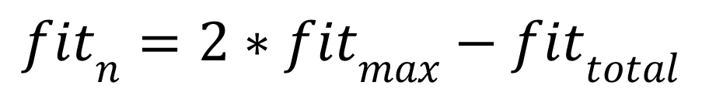
Pseudocode
Cells compete
Total fitness of each species is calculated
Control is given to species with highest fitness
Fitnesses of other species are subtracted out
$${fit}_{n}=2∗{fit}_{max}−{fit}_{total}$$

Slide 18
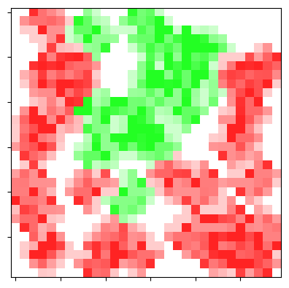
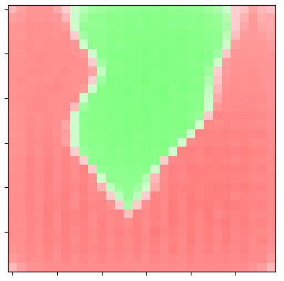
Pseudocode
Repeat growth and competition until a pre-defined convergence condition is met

Slide 19
Results

Slide 20
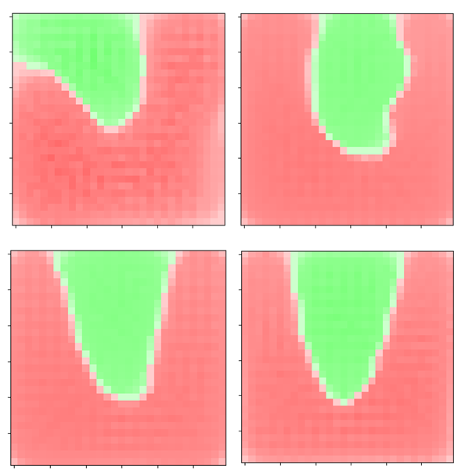
Affects of Increasing Data

Slide 21
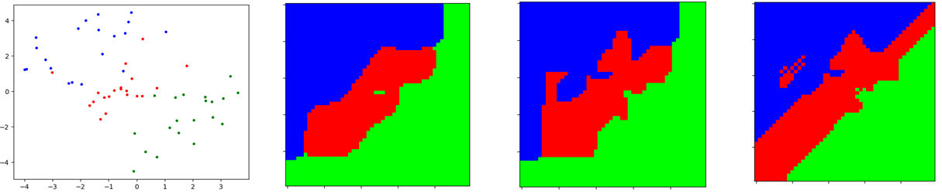
Comparison to Simple Growth
Simple growth methods
Do not consider the shape of the training data
Do not perform well when classes overlap
Training Data
This Method
von Neumann
Moore

Slide 22
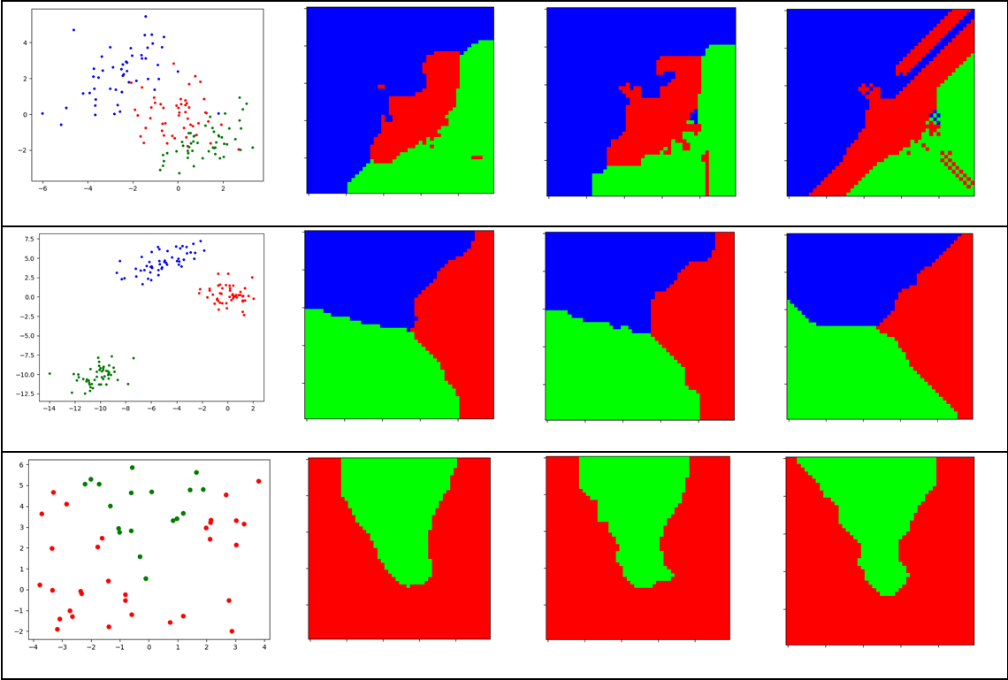
Comparison to Simple Growth
Training Data
This Method
von Neumann
Moore

Slide 23
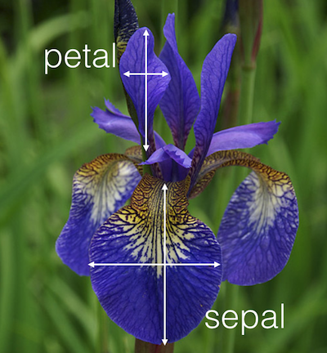
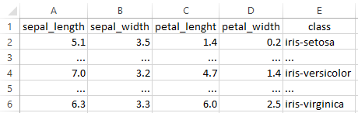
Iris Flower Dataset
Source: Medium
Source: neuraldesigner

Slide 24
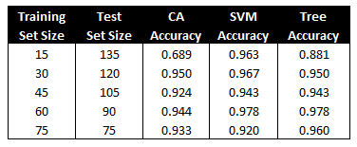
Comparison with Other Classification Methods
Other methods implemented via “sklearn”
Slower than other methods but similar accuracy
12x12x12x12 cell space
50 Growth Cycles

Slide 25
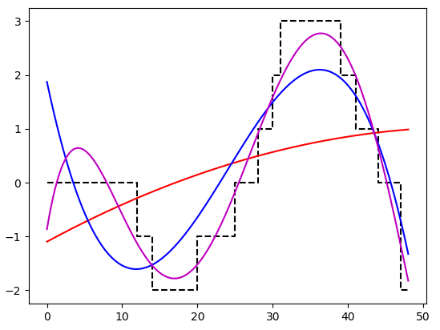
Moving Forward
Viable but implemented naively
Not only a classification method
Estimation of probability distribution
Function fitting and cell boundary analysis

Slide 26
Conclusions
Goals were achieved
More advanced than “simple” growth methods
Comparable results to other models
Potential tool for more than just classification
Areas for improvement
Inefficient
Not thoroughly validated

Slide 27
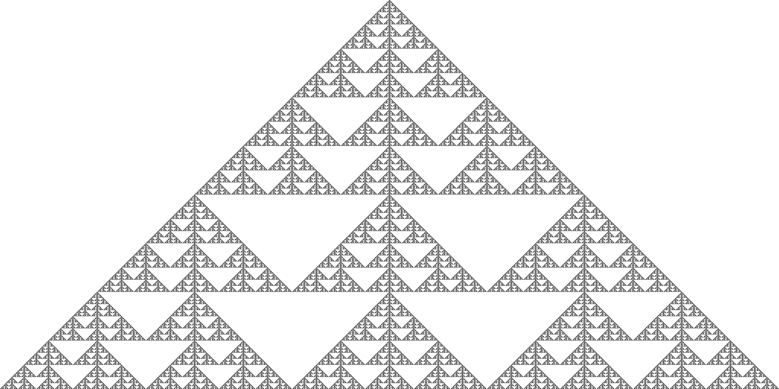
Source: Medium

